Slide 1

ST10287116
PROG6212
CLAIMS MANAGEMENT SYSTEM PROJECT PRESENTATION
BUILT WITH ASP.NET CORE RAZOR PAGES

Slide 2
PURPOSE OF THE APPLICATION
Aa
GOAL OF THE APP
A secure internal portal for lecturers, coordinators, managers, and HR.
Allows staff to submit claims, track progress, and manage approvals.
Ensures only authorized users can access specific views and areas.

Slide 3
CORE FEATURES
01
02
03
04
Secure user authentication (custom auth service)
Role-based authorization using policies
Claims submission form
Manager workflow dashboard
05
06
07
HR reporting area
Validation for claim amounts & submission dates
Razor Pages + partial layouts + clean UI

Slide 4
TECHNOLOGIES USED
FRAMEWORKS & TOOLS:
WHY USE THESE TOOLS:
ASP.NET Core Razor Pages (page-based architecture)
Entity Framework Core (database access)
SQL Server (persistent storage)
Cookie Authentication (user login)
Authorization Policies (role restriction)
Dependency Injection (services like IAuthService, IClaimService)
Bootstrap (styling)
Razor Pages → simple, clean for form-based systems
EF Core → easy model-to-database mapping
Cookies → persistent login session
Policies → security and enforced role restrictions
DI → maintainable, testable code

Slide 5
DATABASE STRUCTURE
Tables
Users
Id, Name, Surname, Email, PasswordHash, Role, HourlyRate
Claims
Id, UserId, Amount, SubmittedAt, Status, etc.

Slide 6
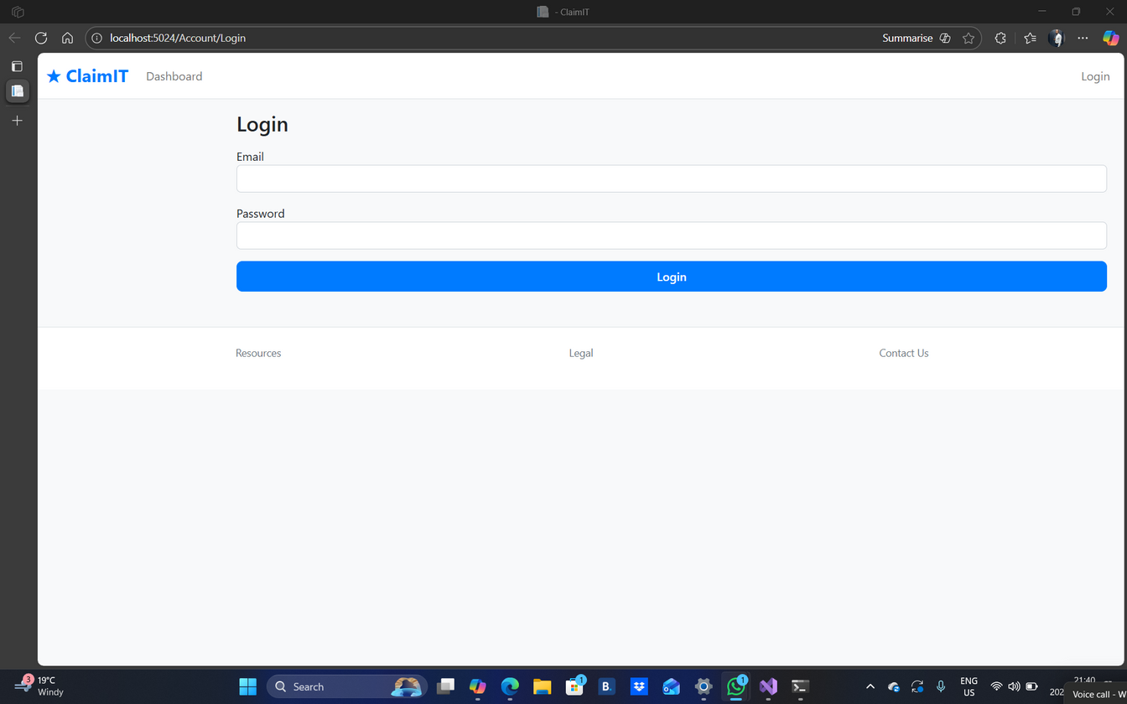
WHAT IT DOES
Accepts email + password
Validates inputs
Calls IAuthService.SignInAsync()
If successful → redirects to home page
If failed → shows error message
CODE SNIPPET
var result = await _auth.SignInAsync(Input.Email, Input.Password);
if (!result.Success)
{
Error = "Authentication failed.";
return Page();
}
Screenshot of login page
LOGIN PAGE
/PAGES/ACCOUNT/LOGIN.CSHTML

Slide 7



AUTHENTICATION FLOW
HOW SIGN-IN WORKS (AUTHSERVICE):
LOOKUP USER BY EMAIL
COMPARE PLAIN PASSWORD WITH STORED HASH (BCRYPT)
CREATE CLAIMS LIST (NAME, ROLE, EMAIL)
SIGN USER IN WITH COOKIE AUTHENTICATION

Slide 8
AUTHENTICATION FLOW
CODE SNIPPET:
VAR IDENTITY = NEW CLAIMSIDENTITY(CLAIMS, COOKIEAUTHENTICATIONDEFAULTS.AUTHENTICATIONSCHEME);
await _http.HttpContext!.SignInAsync(new ClaimsPrincipal(identity));

Slide 9

THIS IS WHERE EACH ROLE LANDS AFTER LOGIN.
DASHBOARD VIEW
Links to Submit Claims
Links to Manager Workflows
If HR: Reports area
CODE SNIPPET:
OPTIONS.CONVENTIONS.AUTHORIZEAREAFOLDER(" HR ", "/REPORTS", "REQUIREMANAGER");

Slide 10
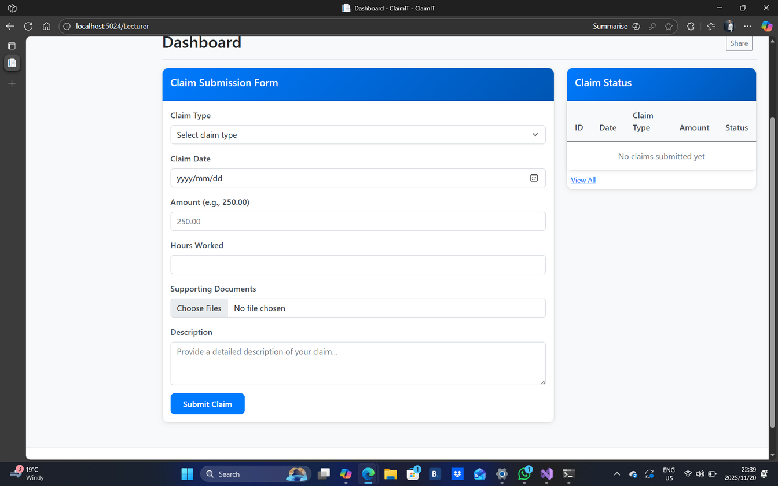
WHAT IT DOES:
DISPLAYS FORM
VALIDATES USING CLAIMVALIDATOR
SAVES TO DB
REDIRECTS TO SUCCESS PAGE
CODE SNIPPET
IF (CLAIM.AMOUNT <= 0)
RETURN VALIDATIONRESULT.INVALID("AMOUNT MUST BE GREATER THAN ZERO.");
/PAGES/CLAIMS/SUBMITCLAIM.CSHTML
SUBMIT CLAIM PAGE

Slide 11
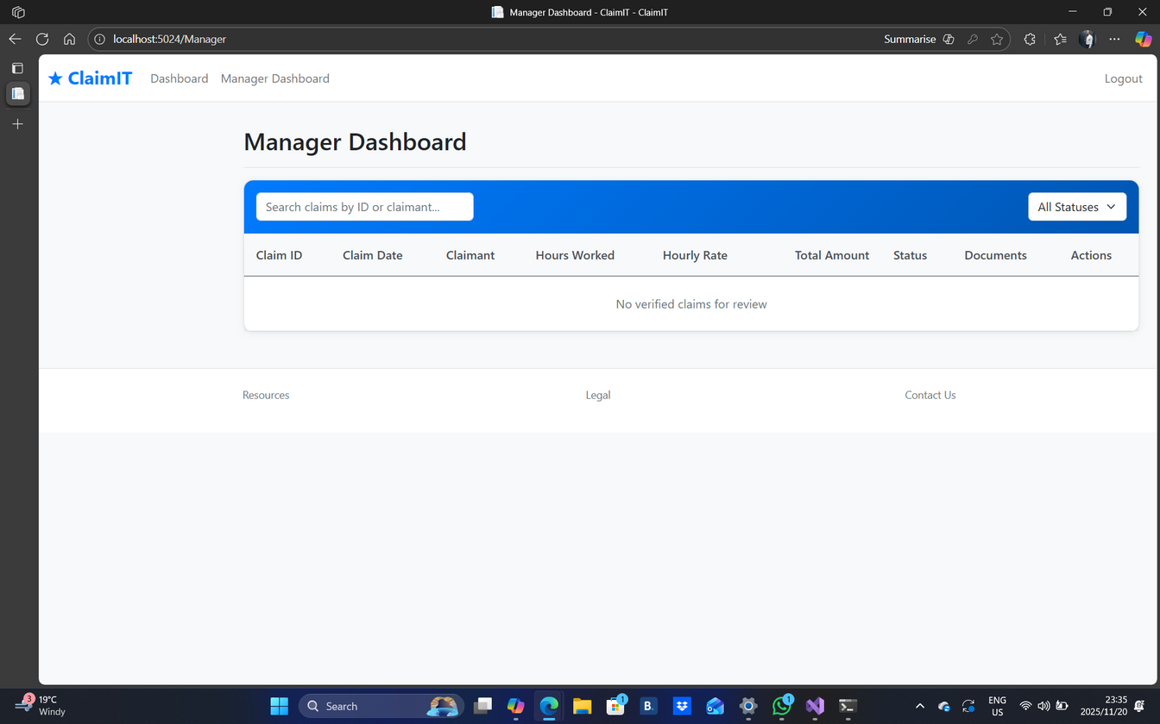
MANAGER WORKFLOW VIEW
PURPOSE
CODE SNIPPET:
LIST ALL PENDING CLAIMS
ALLOWS APPROVAL OR REVIEW
ACCESSIBLE ONLY TO MANAGER ROLE
[AUTHORIZE(POLICY = "REQUIREMANAGER")]
PUBLIC CLASS WORKFLOWCONTROLLER : CONTROLLER
{
PUBLIC ASYNC TASK<IACTIONRESULT> INDEX()
{
VAR PENDING = AWAIT _CLAIMS.GETPENDINGASYNC();
RETURN VIEW(PENDING);
}
}

Slide 12
1
2
3
EXPORT REPORTS
VIEW ARCHIVED CLAIMS
ACCESS DASHBOARDS
CODE SNIPPET:
OPTIONS.CONVENTIONS.AUTHORIZEAREAFOLDER("HR", "/REPORTS", "REQUIREMANAGER");
WHAT HR CAN DO :
HR REPORTS AREA

Slide 13
SYSTEM ARCHITECTURE DIAGRAM
USER
LOGIN PAGE
AUTH SERVICE
COOKIE AUTH
RAZOR PAGES
SQL SERVER

Slide 14
EXPLANATION:
USED TO STANDARDIZE RESPONSES
AVOIDS EXCEPTION OVERUSE
HELPS WITH CLEAN SUCCESS/FAILURE MESSAGES
CODE SNIPPET:
PUBLIC STATIC RESULT<T> FAIL(STRING ERROR) => NEW(FALSE, DEFAULT, ERROR);
RESULT<T> WRAPPER

Slide 15
RAZOR PAGES LAYOUT
CODE SNIPPET
<header>
<partial name="_Nav" />
</header>
<main class="container">
@RenderBody()
</main>

Slide 16
SECURITY CONSIDERATIONS
BCRYPT PASSWORD HASHING
NO PLAINTEXT PASSWORDS
ANTI-FORGERY TOKENS IN FORMS
CLAIMS-BASED AUTHENTICATION
AUTHORIZATION POLICIES PER AREA

Slide 17
THANK YOU
LINK TO VIDEO DEMONSTRATION OF THE WEB APPLICATION: HTTPS://YOUTU.BE/VP5ETLLFHSA

